Slide 1

ABOUT US
L I B R A R I E S
Ganesh
Sivasankaramoorthy
Dharaniraj (Lead)
PyTorch
NLTK
Tranformers
PyMuPdf

Slide 2





WHY WE DID?
CONVERSATION PARSING
_ _ _ _

Slide 3



EXTRACTED FEATURES
_ _ _ _

Slide 4




SIMPLE UI
_ _ _ _

Slide 5

HIGHER ACCURACY
_ _ _ _

Slide 6
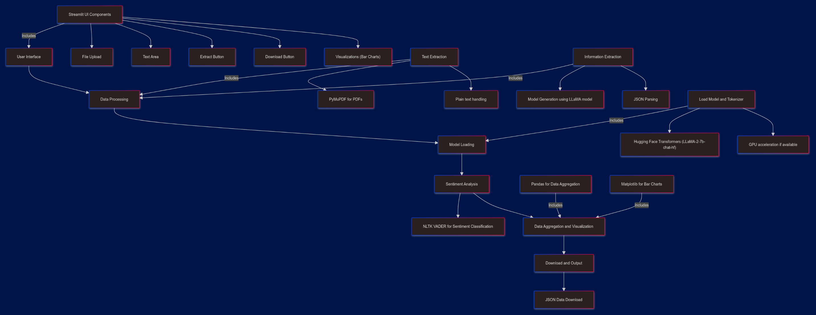
FLOW DIAGRAM

Slide 7
USED LIBRARIES
Transformers | PyMuPdf | NLTK
Llama 2 model integration | Text Extraction From pdf | Sentiment Analysis Of conversation
Prompting Model For Feature extraction | -- | --

Slide 8
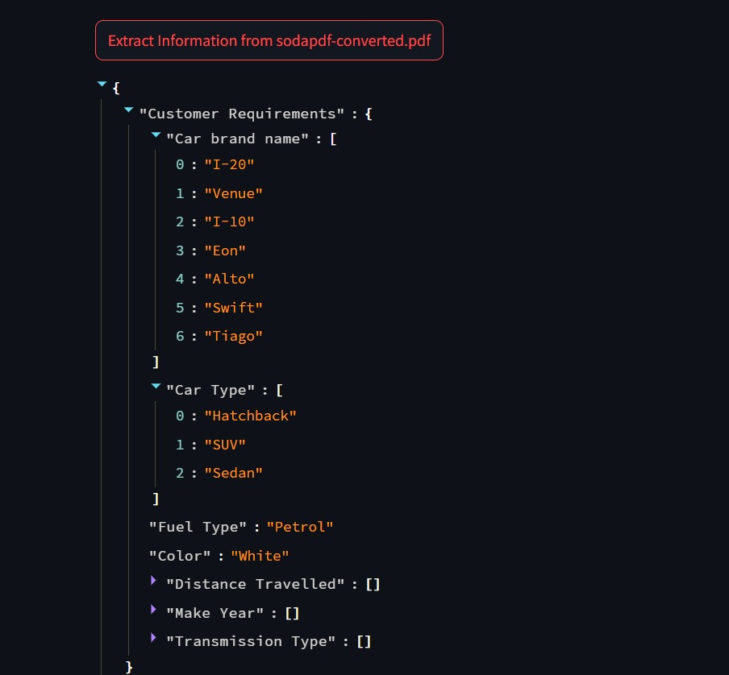
FEATURES EXTRACTION
In the car sales conversation, the customer’s requirements included the type of car (Hatchback, SUV, Sedan), fuel type, color, distance traveled, make year, and transmission type. The company policies discussed were free RC transfer, a 5-day money back guarantee, free RSA for one year, and a return policy. However, the customer raised several objections related to the refurbishment quality, car issues, price issues, and overall customer experience.

Slide 9
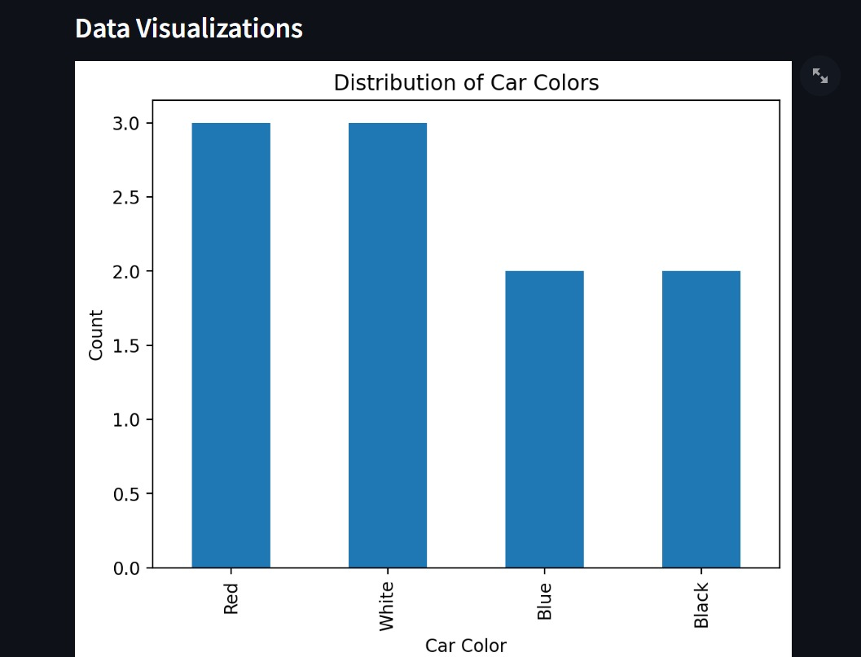
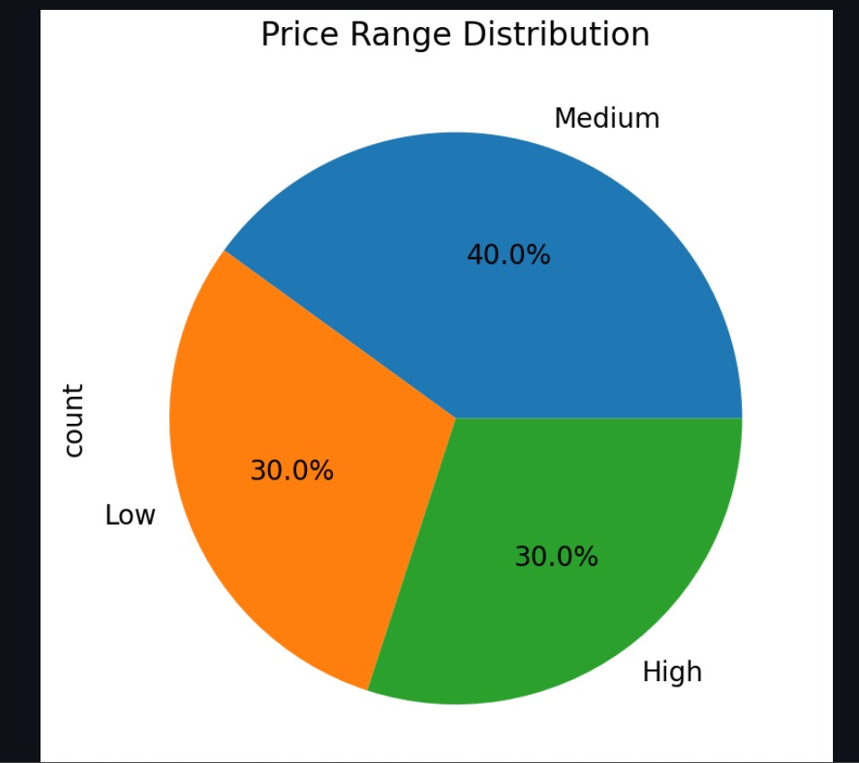

Slide 10

Thank you!
Project Repository

